Slide 1
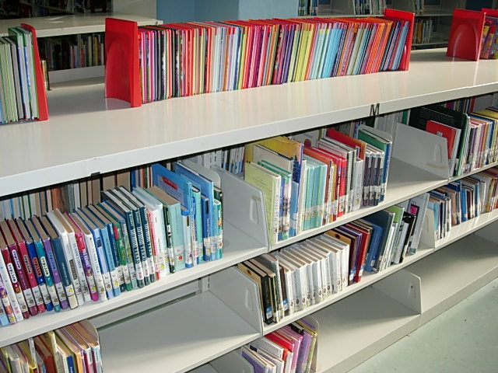
There’s more to our library than just books

Slide 2

A lot of our library is online

Slide 3
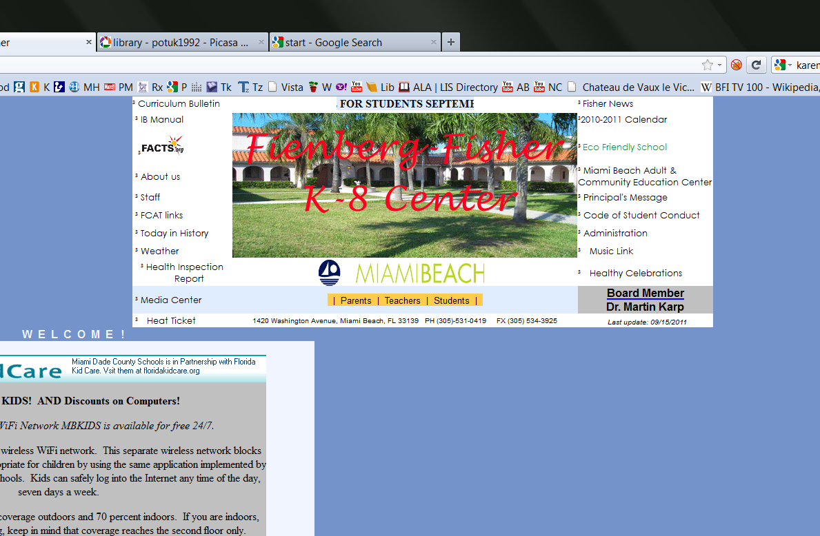
Look at the school website.

Slide 4
fienberg.dadeschools.net

Slide 5
Got it?
fienberg.dadeschools.net

Slide 6
Click on ‘Media Center’

Slide 7
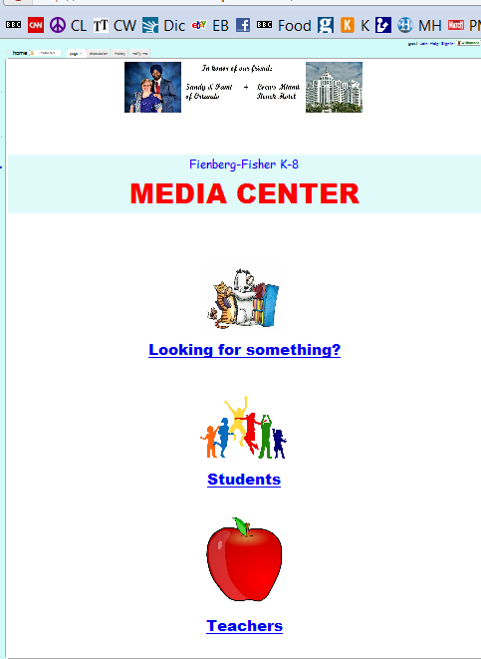
Now you’re at the Media Center home page

Slide 8
Click on ‘Students’

Slide 9
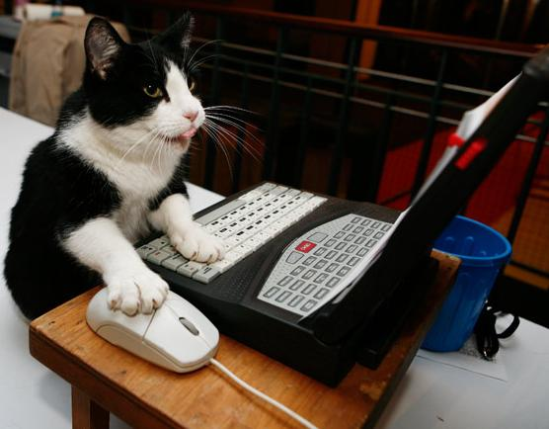

What do you see?
Research

Slide 10


How to make book reports
About
author visits

Slide 11


How to stop bullying /
Best Buddies
Community Service forms + information

Slide 12
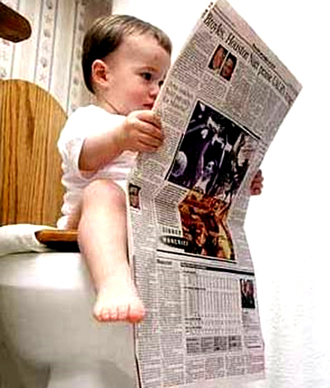


Author sites
News for kids
Moving, talking books for little kids

Slide 13
Important! Important! Important!
If you go to these sites from home
you may need
a log-in name and a password.

Slide 14
Log-in =
miamidade

Slide 15
Password =
miamidade

Slide 16
Let’s go HERE

Slide 17
Click here for ‘Research’

Slide 18
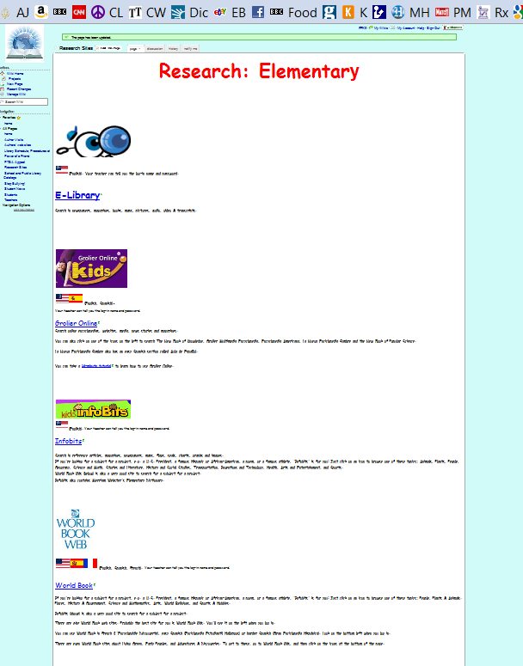
There are several encyclopedia here for elementary school students

Slide 19
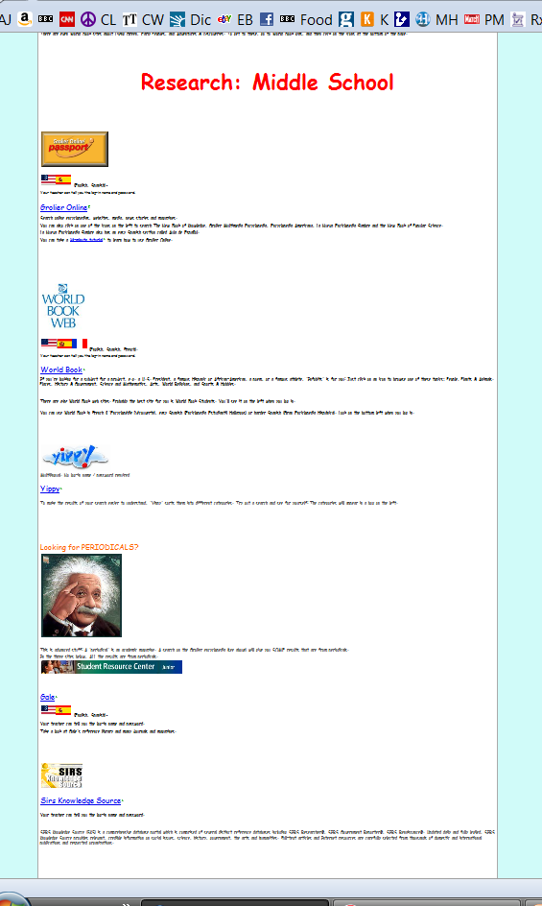
And for middle school students

Slide 20
Try them and see!

Slide 21

Can you remember all that?

Slide 22
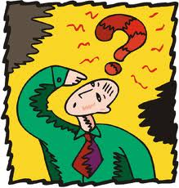
What’s the address of the school website?

Slide 23
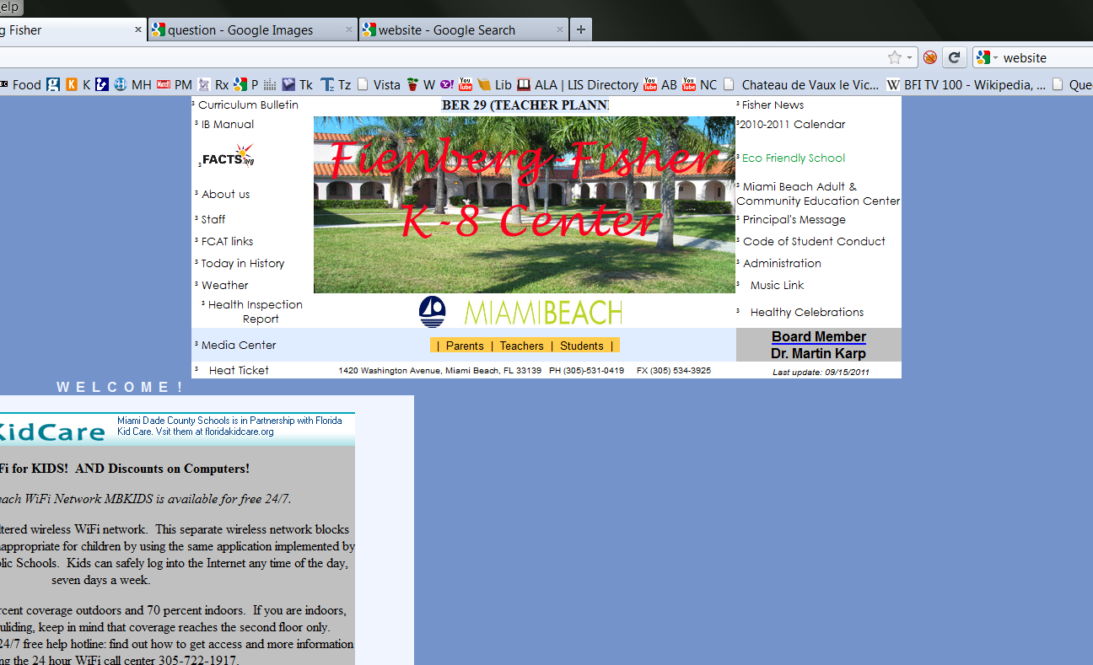
fienberg.dadeschools.net

Slide 24

Then where do you click?

Slide 25
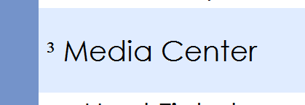

Slide 26
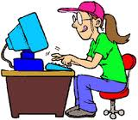
And to go there from home?

Slide 27

What if they want a log-in name?

Slide 28
What if they want a log-in name?
miamidade

Slide 29
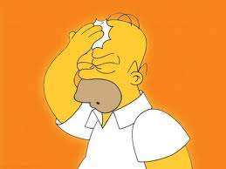
What if they want a password?

Slide 30
What if they want a password?
miamidade

Slide 31


